Slide 1

Factors that impact
Track, Artist, & Genre Popularity
Date: 12/08/2022
Team Members:
Huiting Song
Shiyu Wang
Yichen Guo
Yilin Yang
Zonghong Yu
Notes:
Hello, everyone, we are group 11, our project is to make analysis to determine the factors that impact the tracks, artists, and genres popularity.
My name is Zonghong

Slide 2

Outline
Background
Motivation
Introduction
Project Description
Objective
Data
Methods
Analysis & Results
EDA
Hypothesis testings
Regressions
Conclusions
Notes:
For a brief outline of our presentation, we will provide the background to introduce our topic. Followed by the project description. Then, the team will provide our experiment analysis and results with different sections. TO draw our finally conclusion

Slide 3
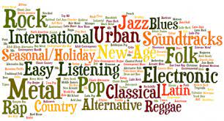

Introduction
Notes:
So, music plays a very common and popular part in our daily life. We may listen to various tracks with many different styles every day. However, based on this word map, we can see that certain styles such as classical pop, metal styles are relatively more popular. Therefore, the team concerns a question which is : why certain types of the music, tracks or certain artists are more popular than others?

Slide 4

Project Description
Objective
What is the important factor(s) that contributes the popularity?
Conclusion
What did we learn?
Future works
Analysis
EDA
Histograms & Correlation Matrix
Hypothesis Testing 1
Difference between genres
Hypothesis Testing 2
Difference between popularities
Regression
Factors that affect popularity
Notes:
Which is the objective, to determine the factors that contributes to the popularity of tracks and genres. In our analysis, the team conducted EDA, 2 hypothesis testings followed by regressions model to achieve our goal and draw our conclusions with future plans

Slide 5
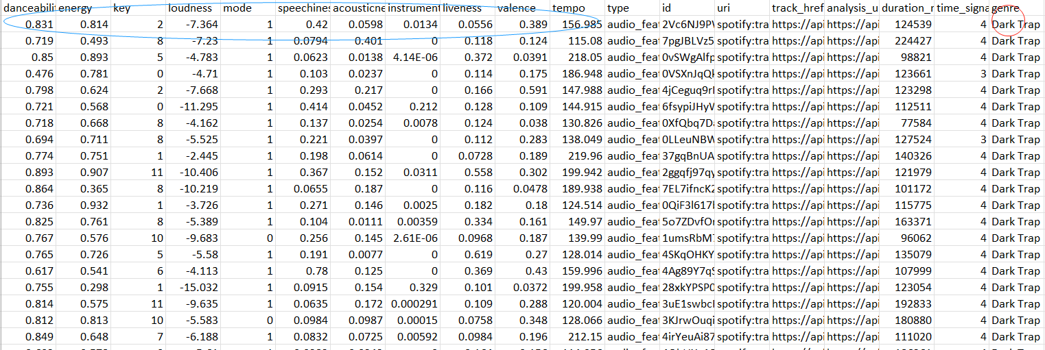
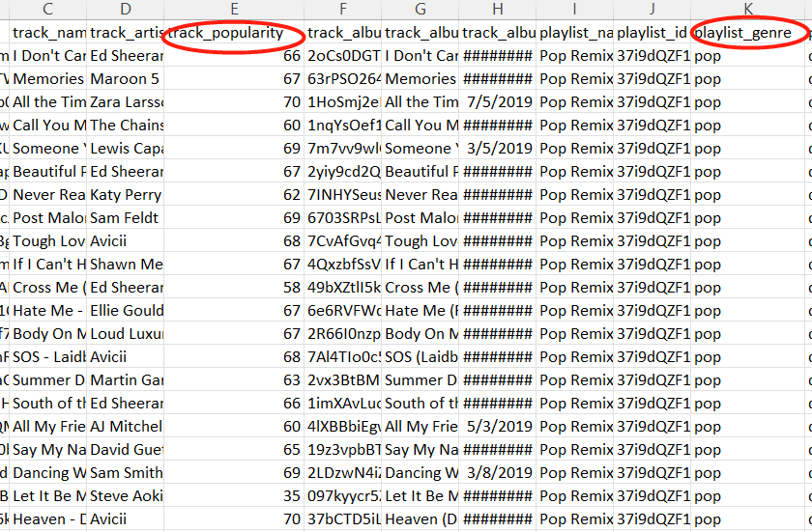
Data Gathering
Source:
Spotify API
Spotify
Tracks
Artists
Genres
Kaggle Datasets
Key Words:
Genre
Artist
Track
Popularity
The popularity of the track
Between 0 and 100
100 being the most popular
Notes:
So the input data that the team chose consist of the datasets utilizing spotify and Kaggle datasets with the key words:
which is the integer

Slide 6
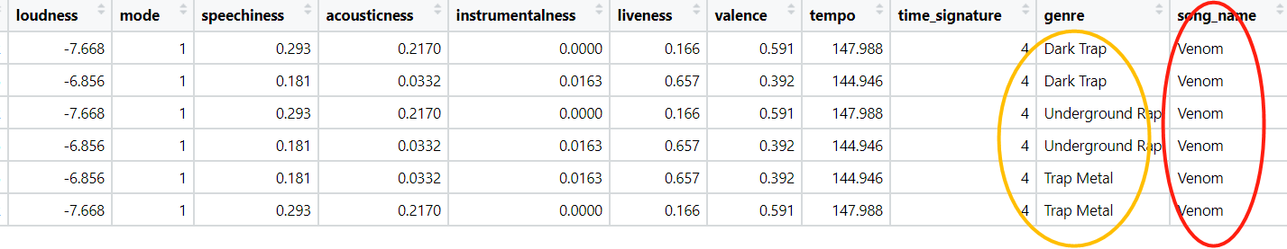
Data Cleaning
Cleaning Process
Check NA values
Check duplicates
Remove unnecessary columns
Major Finding
A song could have different genres
Remove the Duplicates
Notes:
In order to utilize the data with different models. Cleaning processes such as ….. Are crucial for the effectiveness and efficiency.
During cleaning, the major finding is that a song… as you can see from the figure, so the solution is to remove the duplicate such that it can not mess with our model analysis in the later process which starts with the EDA.

Slide 7
EDA

Slide 8
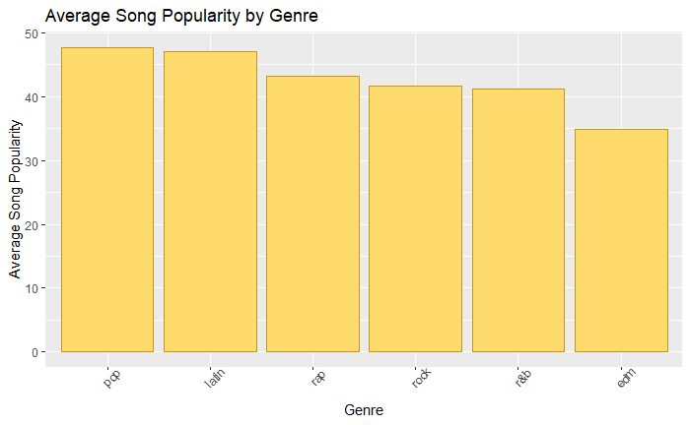
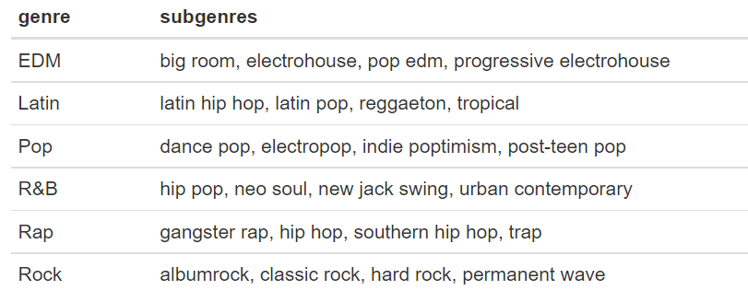
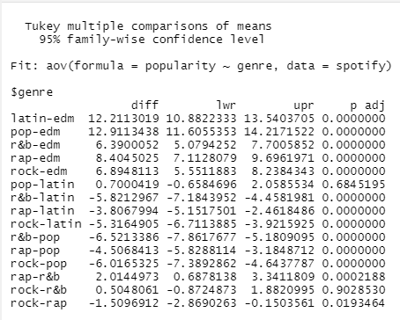
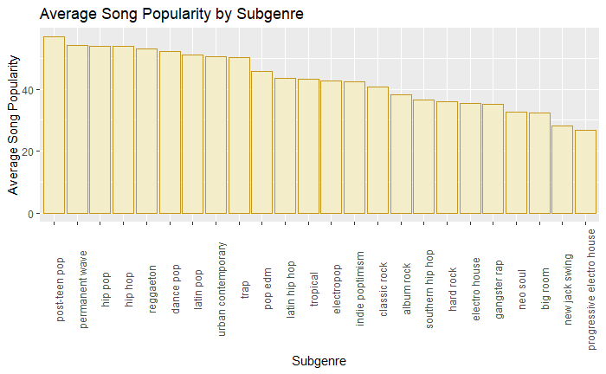
Genre exploration
There are 6 major genre in Spotify tracks and Each of the 6 genres has 4 subgenres
Thus, if an artist wants to increase their chances of producing a popular song or big hits, they should choose the pop genre specifically in the post-teen pop category.
Notes:
Next I wanted to check if the differences in average popularity score for the music genres are significant. To do this I used Tukey’s multiple comparison of means test. The results of this test show that for every genre pairing besides rock and r&b, there is a significant difference in average popularity score.

Slide 9
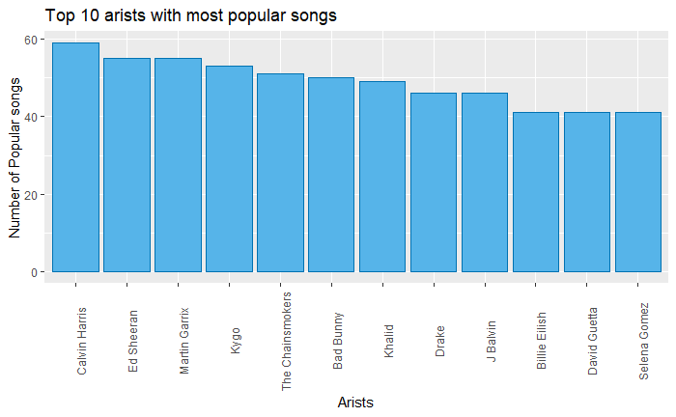
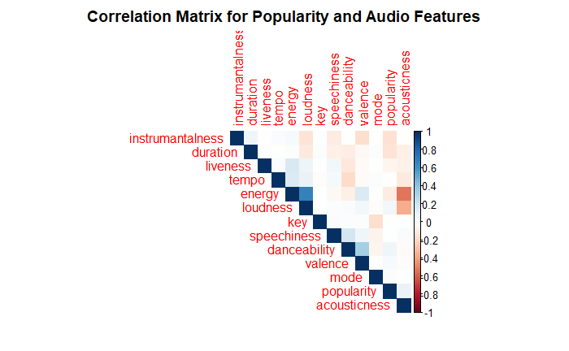
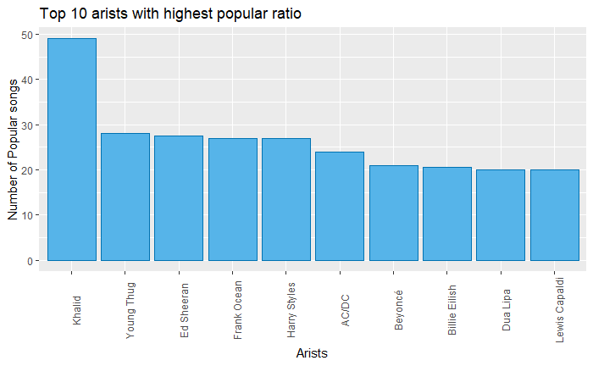
Artists and Audio Features
Popularity Levels:
Popular (Popularity score >= 66)
Moderate (In between)
Not Popular (Popularity score <= 33)
There are 12 different audio features included in this data set such as energy, duration, and tempo.
there aren’t any strong relationships between popularity and the audio features.
Notes:
This table shows the artists with the highest popularity ratio meaning that they not only have a high number of popular songs, but they also have a low number of not popular songs. According to this, Khalid is the artist in the data set that has the highest number of popular songs, and this top 10 looks very different from the previous table where not popular songs were ignored

Slide 10
Hypothesis Testings

Slide 11
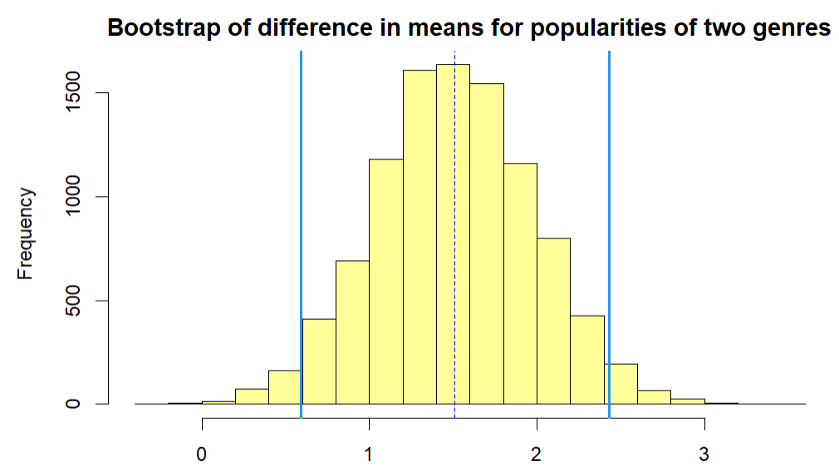
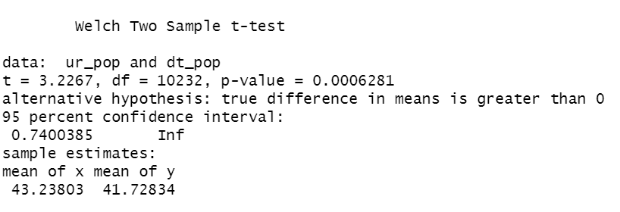

Hypothesis test 1:
Is the population mean of popularity of rap music greater than that of rock music?
Hypothesis:
H0: The mean popularity of rap music is the same as the mean popularity of rock music
Ha: The mean popularity of rap music is higher than the mean popularity of rock music
< 5% significant level
Bootstrap Test: 95% CI
Notes:
in my daily life, i always struggling what kind of music i want to listen. when i am browsing my music list, i found rock and rap account for most of my music list. Therefore, I am interested in the popularity of these two genre. i think the popularity of rap music is the greater than as the popularity of rock music. In this hypothesis test, I will make null hypothesis as the average popularity of rap music is the same as that of rock music, and the alternative hypothesis as the the average popularity of rap music is higher than the popularity of rock music.
Based on the welch two sample t-test and under 5% significant level, since the p-value is smaller than the 0.05, we can reject the null hypothesis. Thus, we have enough evidence to conclude that the average popularity of rap music is higher than that of rock music.
Besides the t.test, I also want to do a bootstrap test here to justify my conclusion at 5% significance level. I will bootstrap the mean difference of popularity of both group. Based on the 95% confidence interval, we are 95% confident that the mean difference will drop in the interval between 0.5916 and 2.432. And also, the confidence interval does not include zero, we can conclude that The mean popularity of rap music is higher than the mean popularity of rock music!
The first hypothesis test is to determine whether the rap music has more popularity than rock music.
Similar procedures are conducted with two sample t-test and bootstrap test, the result shows that the p-value is less than the significant level, which means that …..

Slide 12


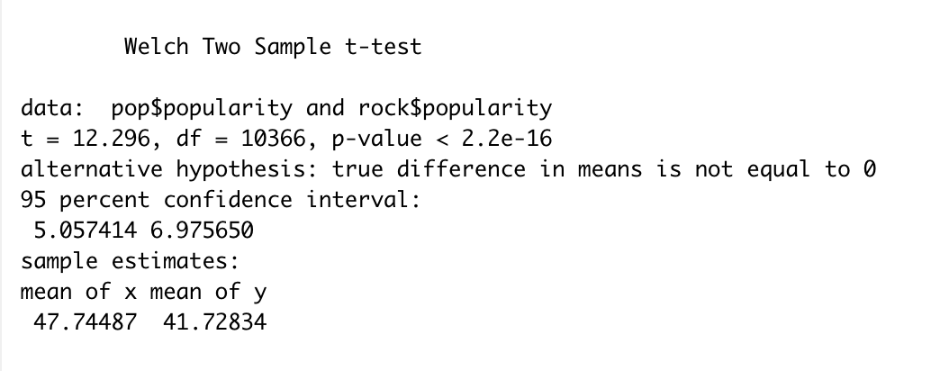
Hypothesis test 1:
Is there a difference between pop music and rap music in terms of the average popularity?
< 5% significant level
Welch Two Sample t-test
Notes:
in my daily life, i alwasy struggling what kind of music i want to listen. when i am scroll my music list, i found rock and pop account for most of my music list. Therefore, I am interested in the popularity of these group of music. i think the popularity of pop music is the same as the popularity of rock music. In this hypothesis test, I will make null hypothesis as the average popularity of pop music is the same as that of rock music, and the alternative hypothesis as the average energy between two group are different.
Based on the two sample t-test and under 5% significant level, since the p-value is smaller than the 0.05, we can reject the null hypothesis. Thus, we have enough evidence to conclude that the average popularity of pop music is not as the same as that of rap music.

Slide 13
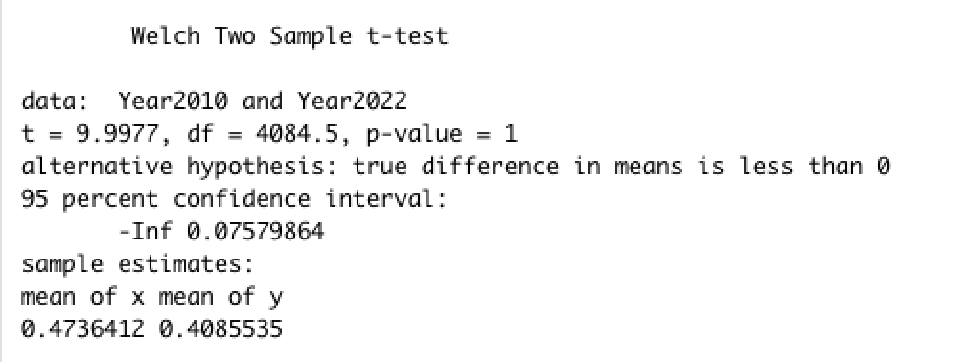
Hypothesis test 2:
Did music style change significantly from 1999-2010 compared to 2011-2022?
Null Hypothesis: The average Valence of songs in 1999-2010 is higher than songs in 2011-2022.
Alternative Hypothesis: The average Valence of songs in 1999-2010 is lower than songs in 2011-2022.
Welch Two Sample t-Test
<0.05
Notes:
After the comparison between genre, we want to learn more about music style change among years. I binned album release year column into two categories which are 1999-2010 and 2011-2022 to see the valence difference between these two ranges of years.
So we have our second Hypothesis:
Did music style change significantly from 1999-2010 compared to 2010-2020?
Our Null Hypothesis predicts that the valence of songs in 1999-2010 is higher than songs in 2011-2022. As we can see in the welch two sample t-test, the p-value is larger than 0.05. So we cannot reject the null hypothesis. Let’s continue to work on bootstrap test to further prove our hypothesis.

Slide 14
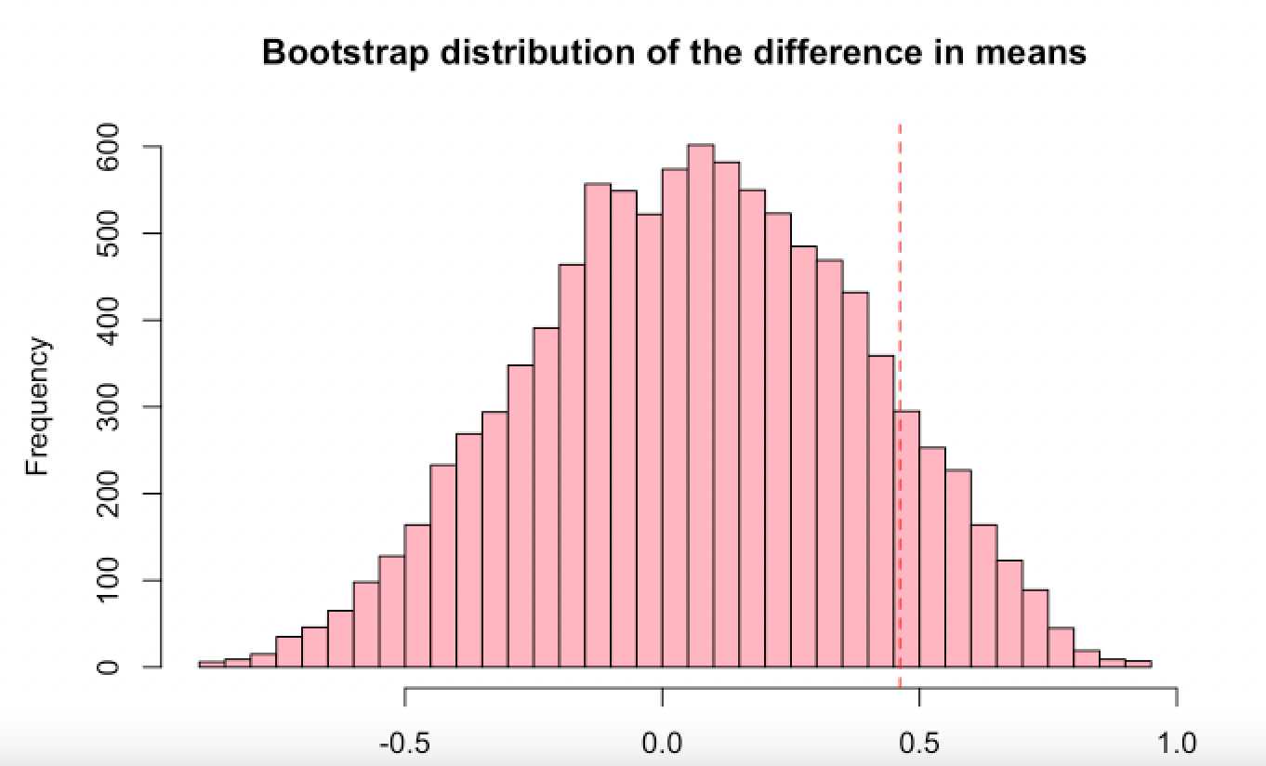
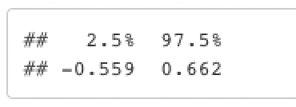
Hypothesis test 2:
Did music style change significantly from 1999-2010 compared to 2011-2022?
Bootstrapping Test
Notes:
Bootstrapping Test is used to prove that the conclusion brought from t-test is true. So we did the bootstrap of the mean difference between year 1999-2010 to 2011-2022. And here comes out the result, as we can see, the 95% confidence interval is between -0.559 to 0.662 which contains zero. So we can conclude that The average Valence of songs in 1999-2010 is higher than songs in 2011-2022.

Slide 15
Regressions

Slide 16
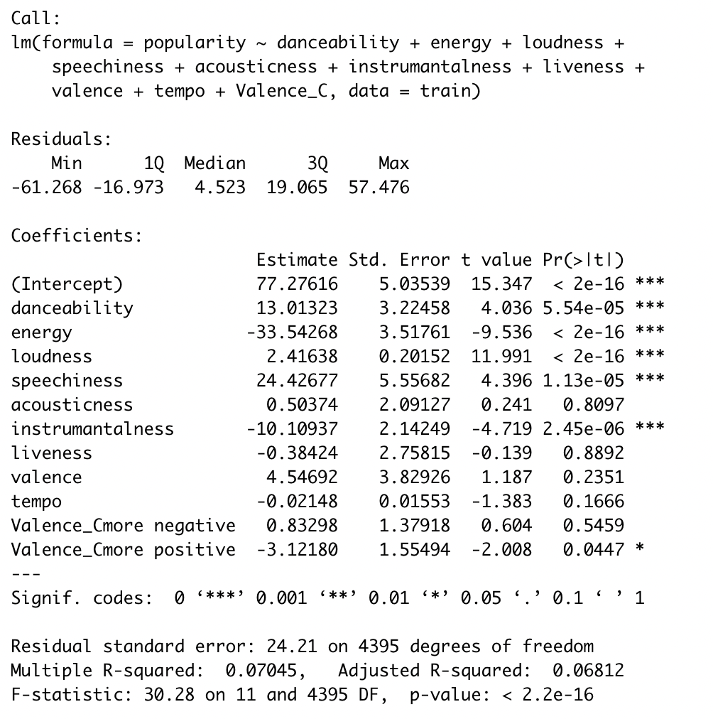
Data Science Question:
Are the variables contributing to predicting “Popularity” of the songs the same with different genres?
Genre: Pop
Model1: full linear regression
Notes:
For linear regression, our goal is to answer the data science question: Are the variables contributing to predicting “popularity” of the songs the same with different genres? Here we chose “pop” and “EDM” music for analysis.
First, we set up a linear regression model with all the possible predicting variables.

Slide 17
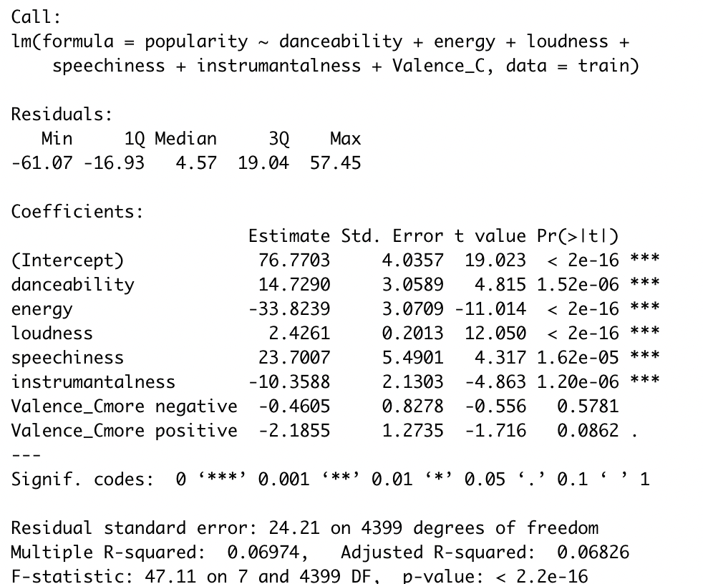
Data Science Question:
Are the variables contributing to predicting “Popularity” of the songs the same with different genres?
Genre: Pop
Model1: full linear regression
Model2: Remove insignificant variables
Notes:
Then, according to the first result, we remove insignificant variables and fit the model again.

Slide 18
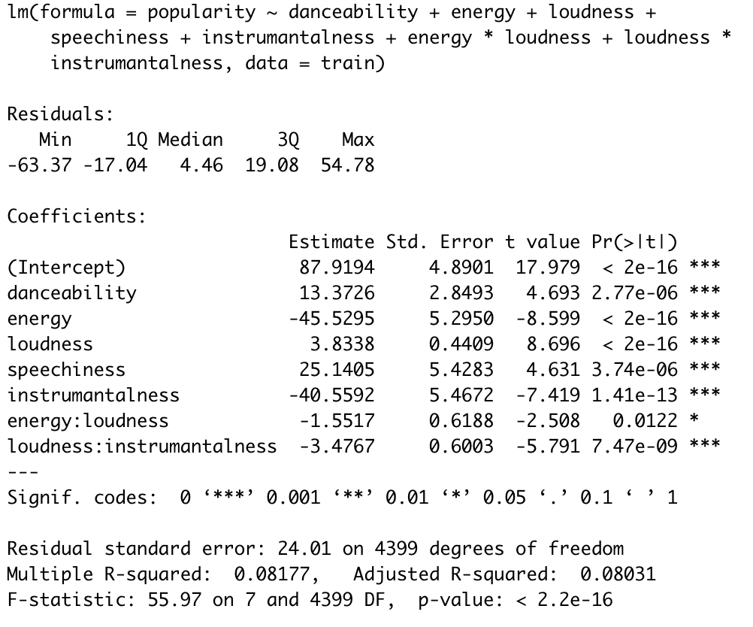
Data Science Question:
Are the variables contributing to predicting “Popularity” of the songs the same with different genres?
Genre: Pop
Model1: full linear regression
Model2: Remove insignificant variables
Model3: Check interactions
Danceability
Energy
Loudness
Speechiness
Instrumentalness
energy*loudness
loudness*instrumentalness
Contributing factors
Notes:
Next, we check the interactions among these significant variables. In this step, we square all the variables and select the significant crossover variables. Here list all the predictors of popularity of pop music.

Slide 19
Data Science Question:
Are the variables contributing to predicting “Popularity” of the songs the same with different genres?
Compare 3 models for POP music
Model | RMSE | R^2 | F stat | Adj R^2 | RSE
fit1 | 24.44 | 0.078 | 30.28 | 0.068 | 24.21
fit2 | 24.43 | 0.079 | 47.11 | 0.068 | 24.21
fit3 | 21.35 | 0.102 | 55.95 | 0.080 | 24.01
Best model
Notes:
Next we compare RMSE, R square, F statistics, adjusted R square and RSE among three models. Obviously model3 is the best.

Slide 20
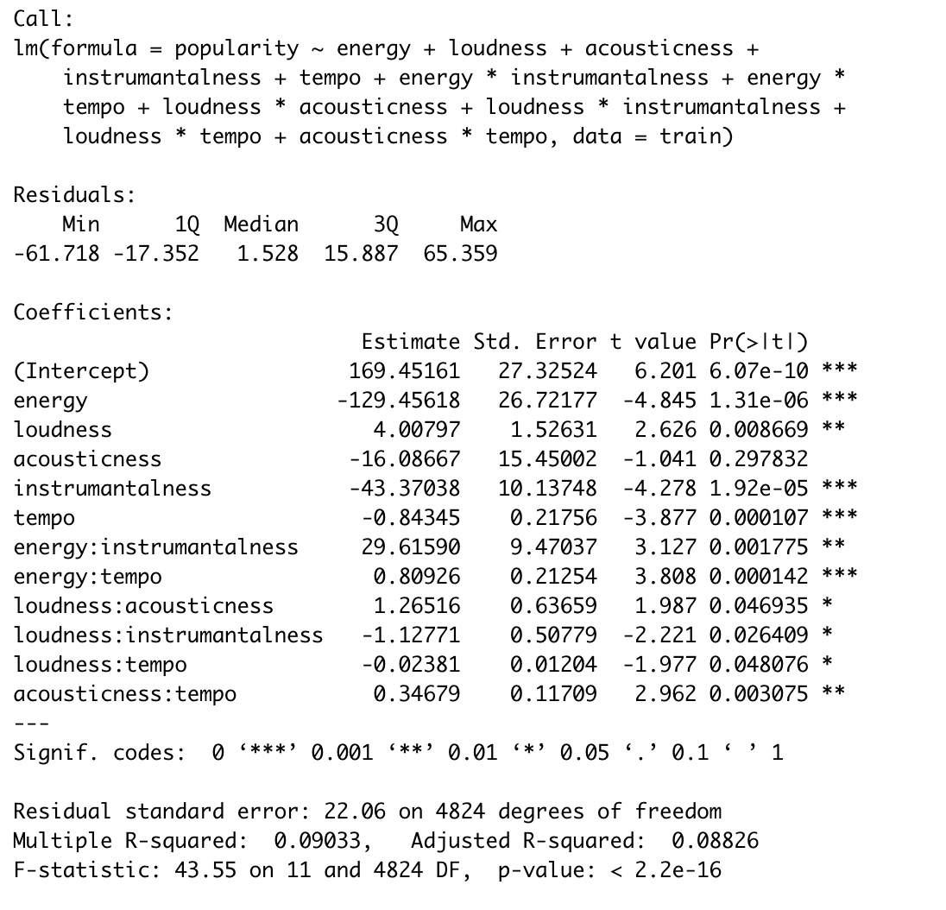
Data Science Question:
Are the variables contributing to predicting “Popularity” of the songs the same with different genres?
Genre: EDM
Model1: full linear regression
Model2: Remove insignificant variables
Model3: Check interactions
Energy
Loudness
Instrumentalness
Tempo
energy*instrumentalness
energy*tempo
loudness*acousticness
loudness*tempo
acousticness*tempo
Contributing factors
Notes:
Next we did the same things with EDM music. Here also list all the contributing predictors of EDM music. Obviously, the contributing factors of POP music are totally different with that of EDM music. This perfectly answers our data science question.

Slide 21
Data Science Question:
Are the variables contributing to predicting “Popularity” of the songs the same with different genres?
Compare 3 models for EDM music
Model | RMSE | R^2 | F stat | Adj R^2 | RSE
fit1 | 22.03 | 0.113 | 42.69 | 0.087 | 22.08
fit2 | 22.04 | 0.112 | 66.94 | 0.087 | 22.07
fit3 | 22.07 | 0.109 | 43.54 | 0.088 | 22.05
Best model
Notes:
Finally we compared models of EDM and chose the best linear regression model.

Slide 22

Conclusions
Many different factors that can affect the popularity
Energy
Loudness
Instrumentalness
Tempo
Each artist and track is unique
Multiple reasons can contribute to the popularity
Different genres provide different popularity
Future analysis
Explore more factors
Audience opinions
Combined genres
Music histories
Regions
Notes:
In conclusion, we have found that there are many ………….. Such as ….
However, each artist….., there can be ……….. Such as different genres, opinions, and districts.
Therefore, for future analysis, in order to make the model more effective, we can explore more factors with new datasets such as ……… to analyze the possible factors thoroughly to improve the results.

Slide 23
Reference
Connecting-with-the-Spotify-API. (n.d.). https://cran.r-project.org/web/packages/spotidy/vignettes/Connecting-with-the-Spotify-API.html
RPubs - Spotify Song Popularity. (2020, November 25). https://rpubs.com/colberam/spotify_popularity_final
Dataset of songs in Spotify. (2020, December 6). Kaggle. https://www.kaggle.com/datasets/mrmorj/dataset-of-songs-in-spotify
One-way MANOVA in SPSS Statistics - Step-by-step procedure with screenshots | Laerd Statistics. (n.d.). https://statistics.laerd.com/spss-tutorials/one-way-manova-using-spss-statistics.php
Schedl, M., Pohle, T., Koenigstein, N., & Knees, P. (2010, August). What's Hot? Estimating Country-specific Artist Popularity. In ISMIR (pp. 117-122)
Ren, J., Shen, J., & Kauffman, R. J. (2016, April). What makes a music track popular in online social networks?. In Proceedings of the 25th International Conference Companion on World Wide Web (pp. 95-96).
Lee, J., & Lee, J. S. (2018). Music popularity: Metrics, characteristics, and audio-based prediction. IEEE Transactions on Multimedia, 20(11), 3173-3182.
Asai, S. (2008). Factors affecting hits in Japanese popular music. Journal of Media Economics, 21(2), 97-113.
Knobloch-Westerwick, S., Musto, P., & Shaw, K. (2008). Rebellion in the top music charts: Defiant messages in rap/hip-hop and rock music 1993 and 2003. Journal of Media Psychology: Theories, Methods, and Applications, 20(1), 15.

Slide 24
Thank You !

